Slide 1
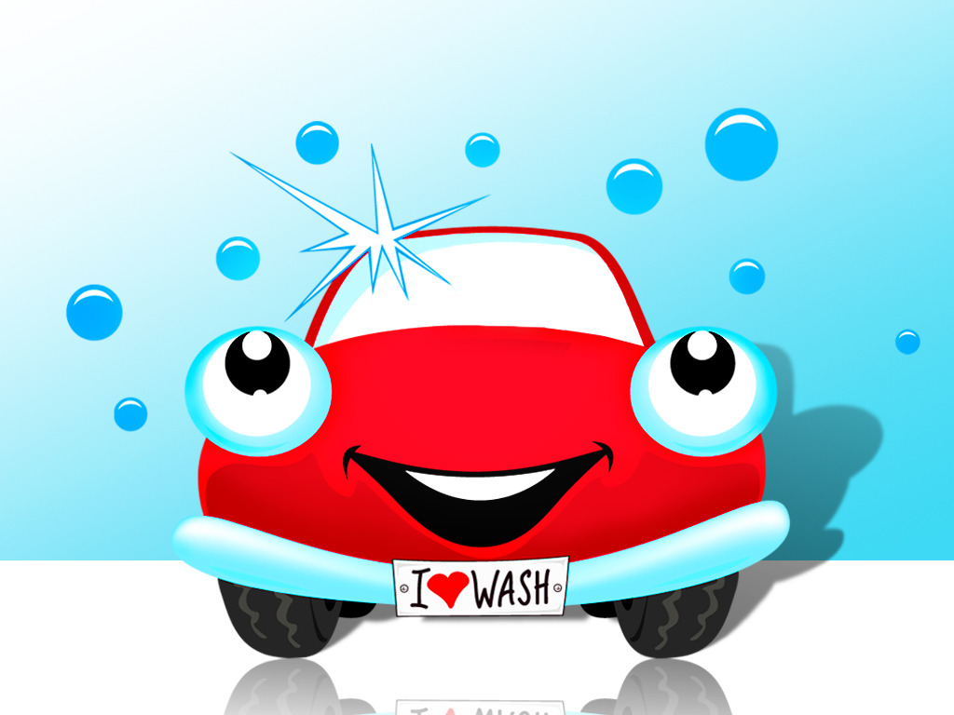
WTW Summer Car Wash
Presenters: Mindy Gigantelli, Gloria Queeno-Chamberlain &
Rebecca Zdon

Slide 2

Agenda
Topic 1: What is a Website “Car Wash”?
  Phases of the Website “Car Wash”
Topic 2: Disable Classic Hierarchy
Topic 3: Remove/Repair “Bad” HTML Code
Lunch Break (30 minutes)
Topic 4: Streamline Formatting
Topic 5: Reformat Table Content
Topic 6: Redesign and Condense Page Content

Slide 3

Topic 1: What is a Website “Car Wash”?
The Webs that Work team has designed a checklist of items that are useful for keeping your website:
    Organized
    Attractive
    Accurate
    Current/Up to Date
    Functional
    Easy to Navigate

Slide 4

Topic 1: What is a Website “Car Wash”?
What options do I have?
  Full Service Car Wash - Salamanca
  Self Service Car Wash – Pine Valley
  Mini Car Wash – All of YOU!
Whatever option you choose, it is important to be aware of the 5 phases involved in the website car wash. All of the phases make up the Website “Car Wash” and will be described in the upcoming slides.

Slide 5
Topic 1: Phases of the Website “Car Wash”
Phase 1 – Pre-wash
  Disable Classic Hierarchy
  Remove Blank Pages
    Be sure to check both the front and back end of the site
  Inactivate or Remove Outdated Content
    Be sure to check both the front and back end of the site
    Empty Recycle Bin periodically
  Verify that all Hyperlinks are Functional
  Reorganize Pages within Section (as needed)
  Check/Update Section Contact Information

Slide 6

Topic 1: Phases of the Website “Car Wash”
Phase 2 – Scrubbing Bubbles:
  Identify and Repair Pages with “Bad” Code
    ie; Microsoft Word
  Redesign & Condense Page Content (as needed)
    Remember Page Layouts!
  Optimize Images/Videos
  Streamline Fonts/Styles/Colors
    Be Consistent!
  Spell/Grammar Check Content
  Reformat Tables (as needed)

Slide 7

Topic 1: Phases of the Website “Car Wash”
Phase 3 – Rinse Cycle: Homepage Tasks
  Remove Unused Apps & Outdated Content
    http://fdrhs.schoolwires.net
  Streamline Fonts/Styles/Colors for Consistency
    http://southmoreland.schoolwires.com (District, HS. Elem?)
  Check/Correct App Placement for Consistency
    http://jsasd.schoolwires.com
  Verify Address/Phone Number Info.
    Site Settings
  Update Photo Galleries
  Organize Site Shortcuts
    Hamburg - Union Pleasant Elementary
    Kenmore - Franklin Elementary
  Create Emergency Announcement App (Optional)
    Salamanca - Scrolling Marquee
    Campbell Savona - Hidden Flex App
    HTML5 Maker - Flash Free Animations

Slide 8
Topic 1: Phases of the Website “Car Wash”
Phase 4 – Interior Detail
  Remove Outdated User Accounts
  Remove Outdated Groups
  Update Calendar Collections
  Update Group Membership
  Update Passports
    Verify Registered Users have the Correct Passport
  Update Section Configurations
    Delete Outdated Configurations

Slide 9

Topic 1: Phases of the Website “Car Wash”
Phase 5 – High Gloss Finish
  Review Channels, Sections, and Pages and offer recommendations for reorganization and overall improvement.

Slide 10

Topic 2: Disable Classic Hierarchy
Classic Hierarchy was the method of organizing pages within a section in Centricity 1.
  Classic Hierarchy is difficult to use and outdated, therefore it should be turned off when possible.
Demo:
  Disable Classic Hierarchy within the Section
  Use the Organize Pages feature
  Map pages, as needed
  Turn off Classic Hierarchy permanently (Section Options)

Slide 11

Topic 3: “Bad” HTML Code
Certain pages contain what we call “bad” HTML code. At times this code can make it difficult to format, edit, or even save content.
This “bad” HTML code can come from various sources.
  Copying and pasting from one application to another
  Recycling the same app without clearing the previous formatting
  Inserting 3rd party code within the editor
    i.e.; Embed Code

Slide 12
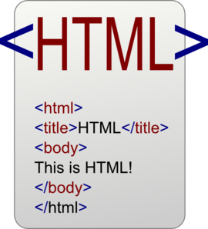
Topic 3: Continued…
Basic HTML Format Tags
<p> – defines a paragraph, like a paragraph in a book
<br> – defines a line break
<strong> - applies a bold format to text
<em> – applies emphasis to text
<table> - defines a Table
  <tr> - table row
  <td> - table data (think of a cell in Excel)

Slide 13
Topic 3: Continued…
Basic HTML Format Tags
<img> - defines an image
<a> – defines a hyperlink
<li> - defines a list, ordered <ol> or unordered <ul>
<span> – defines a section in a document (inline),
  Inline elements are normally displayed without starting a new line.
  Can be used to apply formatting, especially when copied from another application

Slide 14
Topic 3: Continued…
Basic HTML Format Tags
<div> – defines a section in a document (block level)
  block level element – normally start/end with a new line
  can be used as a container for grouping other HTML elements
Mso – defines code created using Microsoft Office
  Examples: class="MsoNormal“, mso-list, mso-bidi-font-family: Wingdings;
http://www.w3schools.com/tags/

Slide 15


Topic 3: Continued…
3 Options for removing “bad” code:
  Cut content and use the Paste Plain Text button
    Works like Notepad, strips HTML code out.
  Select the text, click the Clear Formatting button
    You may need to click it several times, until all formatting is removed!
  Place your cursor in the problematic text. Click the HTML tag (bottom of editor) and select the Delete Tag option.
    You may need to remove multiple tags for each piece of content.

Slide 16

Topic 4: Streamline Formatting
Your website is a reflection of your district. When creating pages, you should keep the following in mind:
  The type, size and color of font should be consistent throughout your site.
  Line Spacing - be consistent!
  App Titles – be consistent!
Note: It is important to define a set of district Web Standards.

Slide 17

Topic 5: Reformat Table Content
In HTML, the original purpose of tables was to present tabular data. It should NOT be used to manipulate the layout of a Webpage.
  USE A Table if:
  You are going to have header fields at the top of columns of data or to the left of rows of data, then it is tabular
  If the contents make sense in a database or a spreadsheet and you just want to display the data and not make it pretty use a table.
You should NOT use a table if:
  The main purpose of the table is to position the contents on the page in some way. ie: to add space around an image, or add bullets to a list.
Solution: Change the page layout to multiple columns and use multiple apps on the page.

Slide 18

Topic 6: Redesign and Condense Page Content
Think outside the box!
  Explore new apps! (OVER 30 Apps available)
  Instead of using a flex editor for a long list of hyperlinks consider using a link library.
  As an alternative to using a flex editor to provide daily homework assignments, consider using the homework assignment app or an article library app.
  If you have pages with related content, consider combining the apps into one page.
    Instead of people visiting a few pages for all the information they need they can read it all in one place.
Notes:
Change the sample on the demo site – so that there are 3 pages of content converted to 1 page.

Slide 19

Topic 7: User Management
Remove old/outdated user accounts.
Remove unused groups.
Update group memberships and passports,

Slide 20

Helpful Hints
Notify editors before & after conducting the website “car wash”.
If you disable Classic Hierarchy, make sure that you notify editors and train them to use Organize Pages.
Go to the Site Workspace/Tools/Reports and run the Last Modified report.
Don’t forget the check Site Manager for hidden or inactive pages/sections/channels.
Empty the recycle bin.
  Deleting the page does not delete the app(s) from the app manager, unless you empty the recycle bin.
Create or update your web standards and distribute them to all editors.
If you reorganize the layout of your website post a message on your homepage to inform the public and indicate who they can contact if they have questions.

Slide 21


Wrap Up
Work time:
  Finish your “Mini Car Wash”
  If you have finished one section, move on to the next!

Slide 22
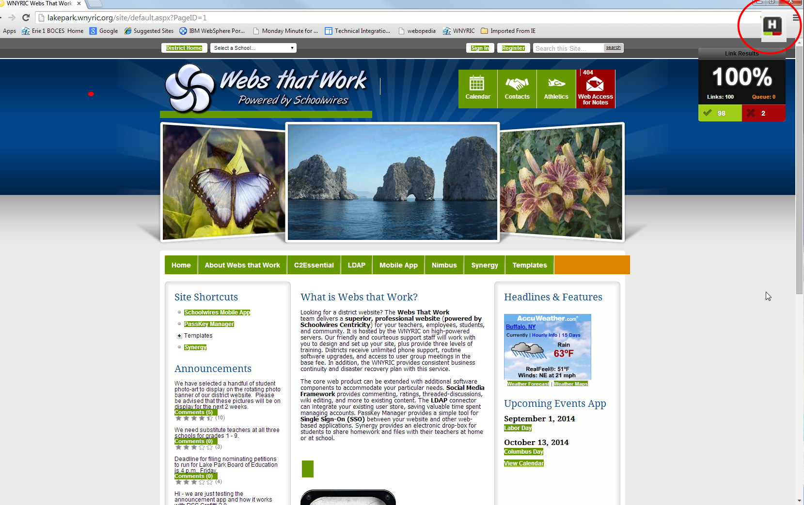
Google Check My Links
BACK

